Slide 1



Microsoft Office SharePoint Server 2007 (MOSS 2007) Overview
Presented by Tarek Ghazali
IT Technical Specialist
Microsoft SQL Server MVP
Microsoft SQL Server 2005 MCTS
Web Development MCP
DevLifeStyle Vice President – KSA Community
LebDev Vice President – Lebanese Dev. Community
© 2008 Tarek Ghazali. All rights reserved.

Slide 2
MOSS 2007
Overview
MOSS 2007 is an integrated suite of easy-to-use server applications that provides a single platform to manage intranet, extranet and website applications across your organization

Slide 3






SharePoint Feature Areas
Server-based Excel spreadsheets and data visualization, Report Center, BI Web Parts, KPIs/Dashboards
Docs/tasks/calendars, blogs, wikis, e-mail integration, project management “lite”, Outlook integration,
offline docs/lists
Business
Intelligence
Collaboration
Platform
Services
Rich and Web forms based front-ends, Line Of Business actions, pluggable SSO
Enterprise Portal template, Site Directory, My Sites, social networking, privacy control
Business
Processes
Portal
Workspaces, Mgmt,
Security, Storage,
Topology, Site Model
Content
Management
Search
Integrated document management, records management, and Web content management with policies and workflow
Enterprise scalability,
contextual relevance, rich
people and business data search

Slide 4
MOSS 2007
Platform Services
Platform
Services
User Experience
  Improvements to usability, navigation, customization
  UI improvements
    Security trimmed, breadcrumbs, Quick Launch in view, easy to access views
  Recycle Bin
Platform Improvements
  ASP.NET 2.0 - web parts, master pages, pluggable authentication
    Full compatibility with WSS v2 Web Parts
  Customization enhancements – templates, feature extensibility
  Windows Workflow Foundation
  List enhancements – scale, content types, versioning, Recycle Bin
Manageability
  Improved backup \ restore
  Extranet deployment with ADFS and reverse proxy support

Slide 5
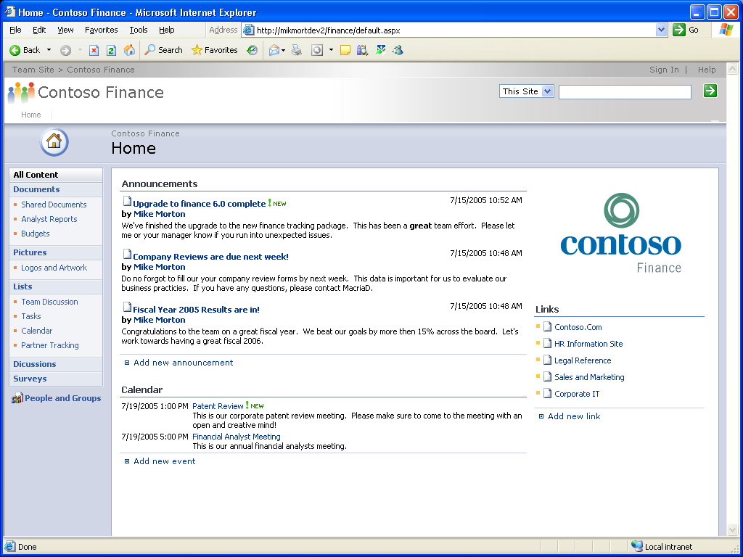

Security Trimmed UI
Platform
Services
Commands only available when logged in user has permissions to access

Slide 6
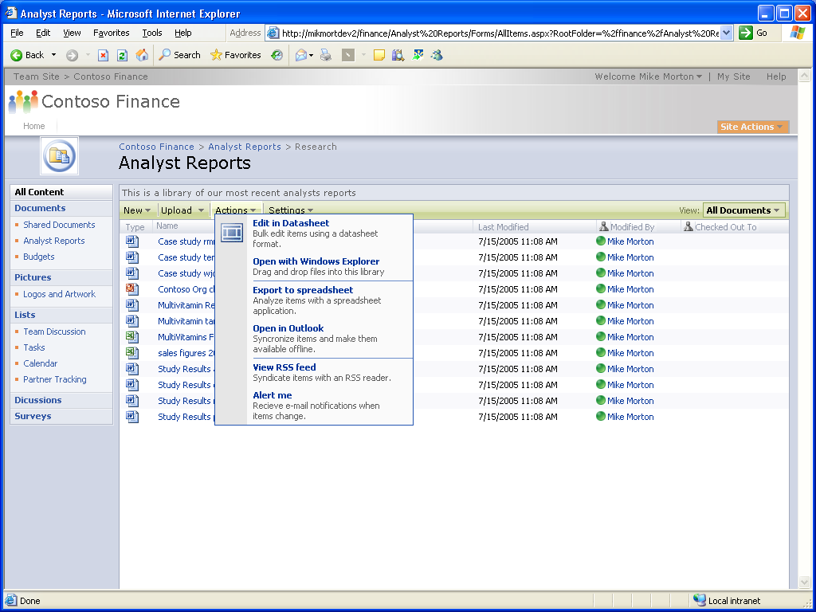
Navigation, List, Menu Improvements
Platform
Services
Automatic breadcrumb
Persistent Quick Launch links

Slide 7
MOSS 2007
Master Pages & Authentication
Platform
Services
Master Pages
  Each page in WSS “points” to a master page
  Each WSS site has a Master Page Gallery (MPG)
  What does that mean? You can now completely re-skin an entire SharePoint site by changing one file.
Authentication
  Authentication types
    Windows : Active Directory
    ASP.NET: SQL, LDAP or any other ASP.NET 2.0 Membership Provider
  What does that mean? You can now authenticate internal users and external users for the same site from separate directories. No need to create AD accounts for external users.

Slide 8
MOSS 2007
Collaboration
Collaboration
Collaboration Allow teams to work together effectively, collaborate on and publish documents, maintain task lists, implement workflows, and share information through the use of wikis and blogs.

Slide 9
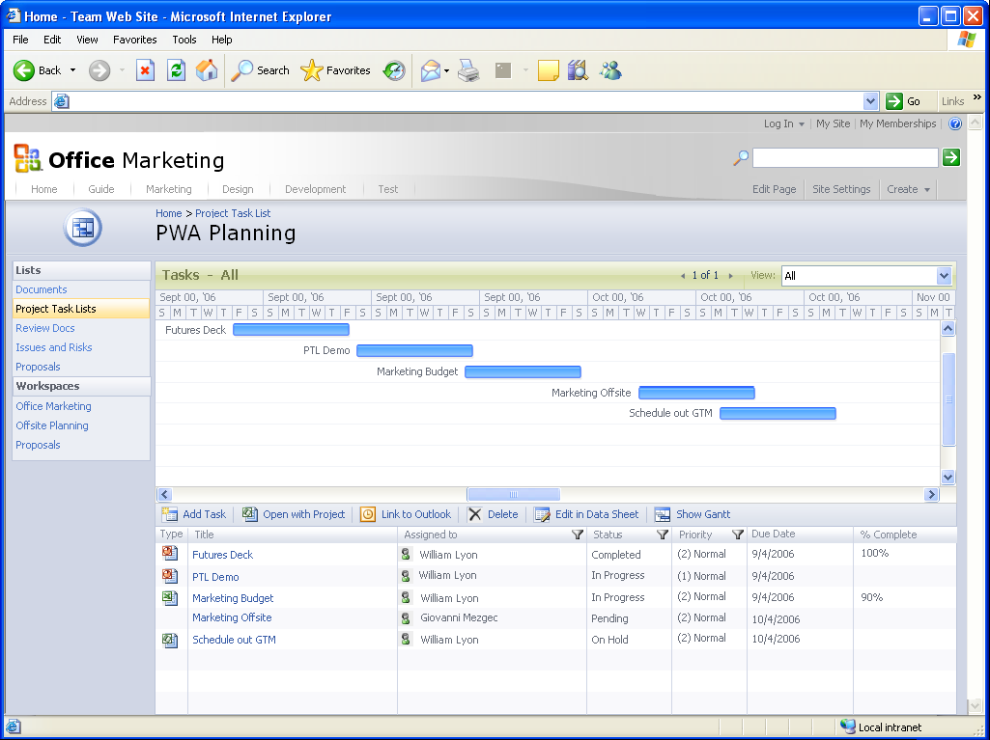
Project Management “Lite”
Collaboration
Easy Gantt
Charting
Project Task List in SharePoint sites for ad-hoc projects
Simple List of Tasks and Dependencies
Promote to Project Professional

Slide 10
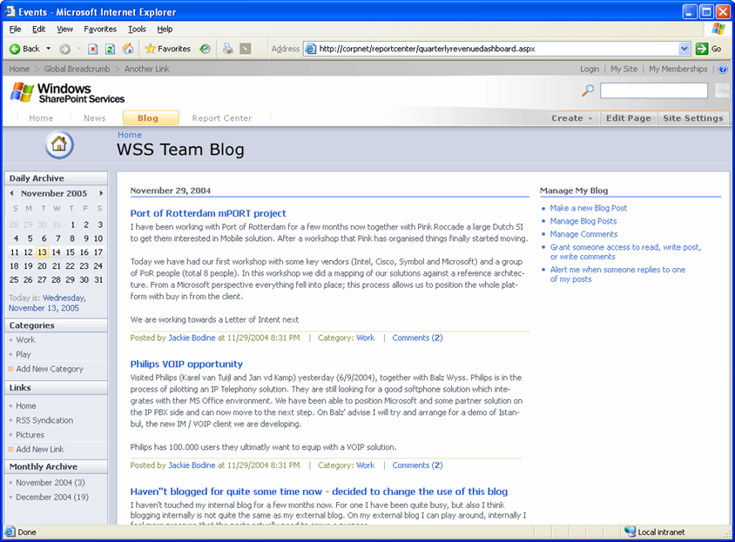
Blog
Collaboration

Slide 11
MOSS 2007
Portal
Portal
Portals Create a personal MySite portal to share information with others and personalize the user experience and content of an enterprise Web site based on the user’s profile.

Slide 12
Portal Improvements
Portal
Portal Creation
  Starter site to build out the Intranet presence site
  Contains many common applications and layouts
  (Employee Finder, I Need To, Highlight/News of the day, News, Site Directory)
  Create as many portals as disk and processor allow (just like team sites)
    Self-service portal site creation
    Support for hosted scenario
  Multi-language Support
    Create areas in different languages on the same Portal
    Create team sites in different languages on the same Portal
My Site
  Richer Information OOB
    SharePoint sites roll-up, Documents and Tasks, Colleagues (and what has changed), Self-configuring OWA parts
  Your own site – really!
    Add your own web parts, Customize in SharePoint Designer (Front Page)
Leverage all WSS features
  Offline docs and calendar in Outlook
  Personal blogs

Slide 13
Search Investment…
Search
Integral part of Portal and Content Management across repositories (e.g. SAP, Support Application,…)
Search Center
  Standard tabbed interface
Search Basics
  Top 10 on first page
  Query hit highlighting
  Search syntax matching de facto standards
  Duplicate collapsing
  “Did you mean” query correction
  Editorial results (Best Bets) and definitions
  Alerts
  More…

Slide 14
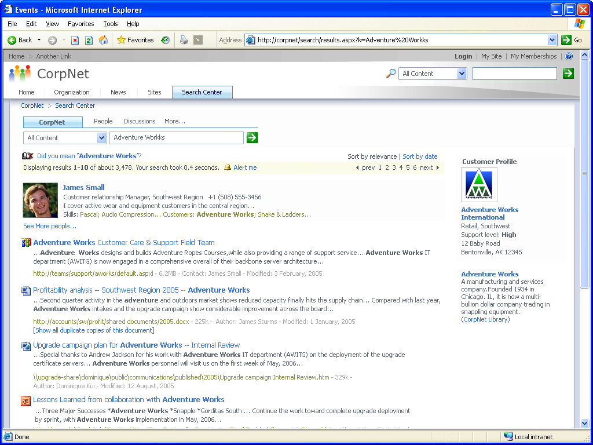





Better Search Results
Search
Tabbed interface
“Did you mean” query correction
Alerts on
search results
Query hit highlighting

Slide 15
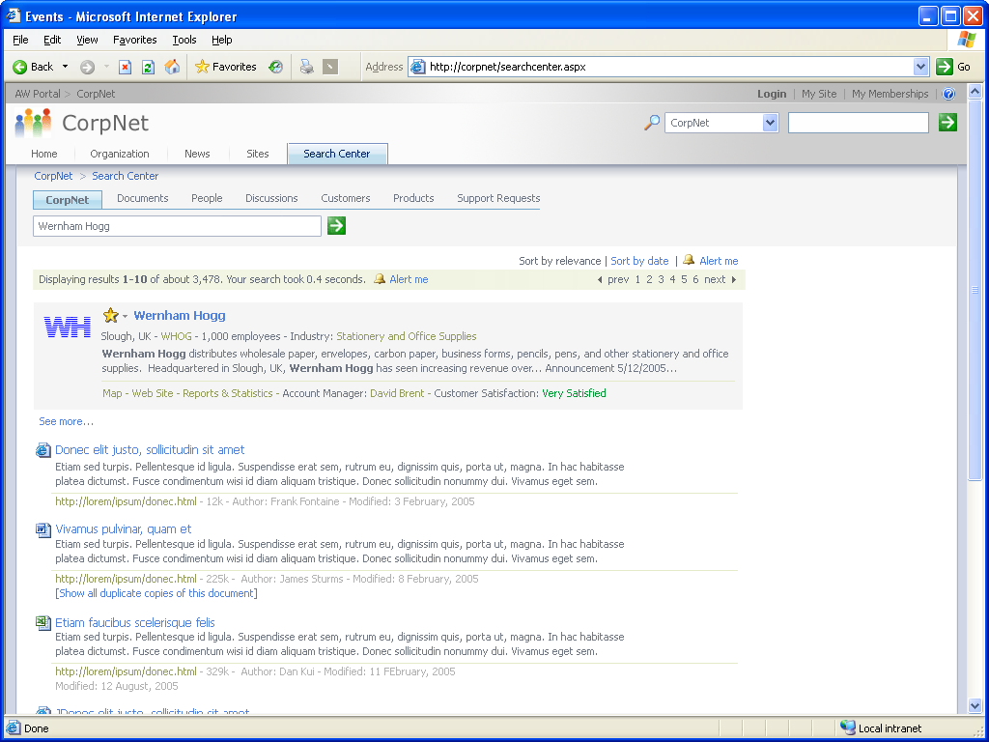
Across Repositories
Customer Search / Support Search
Search
Customer data from SAP system
Incidents from custom support system

Slide 16





Content Management
Content
Management
Document Management
Workflow
Records Management
Web Content Management

Slide 17
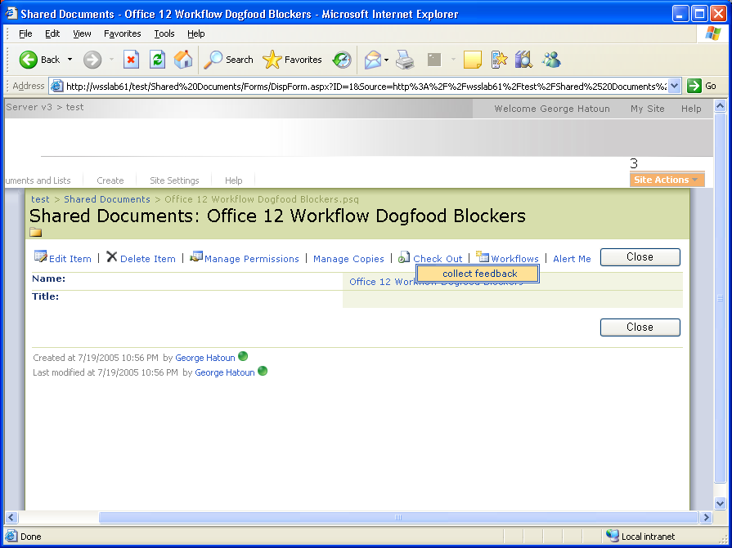
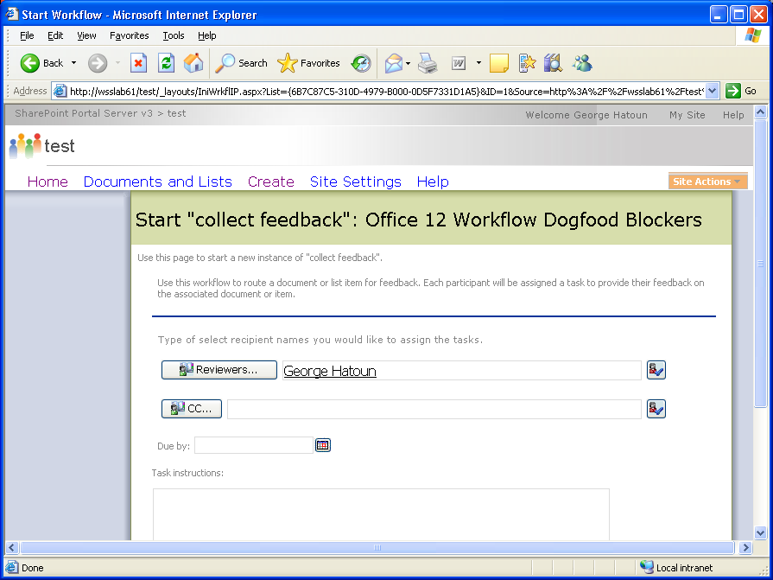
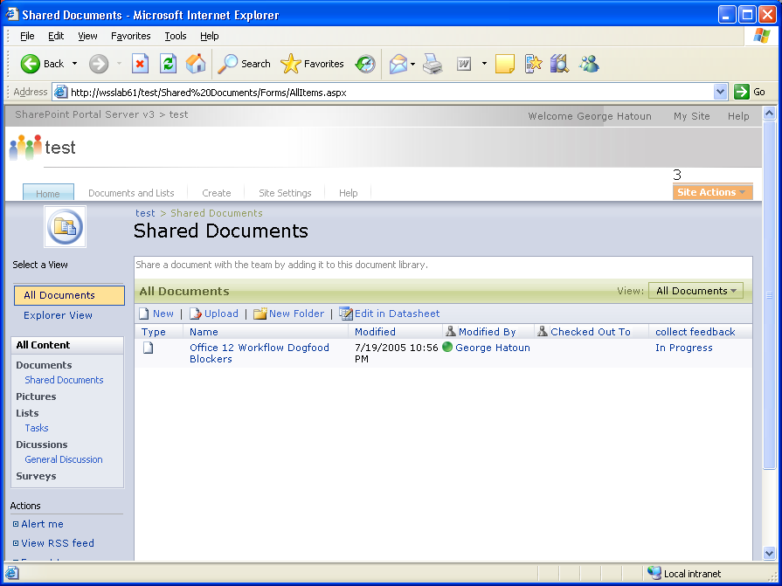
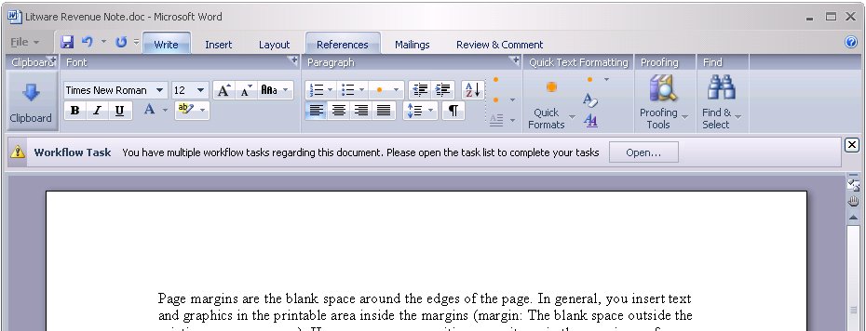
Easy Workflow…
Content
Management

Slide 18
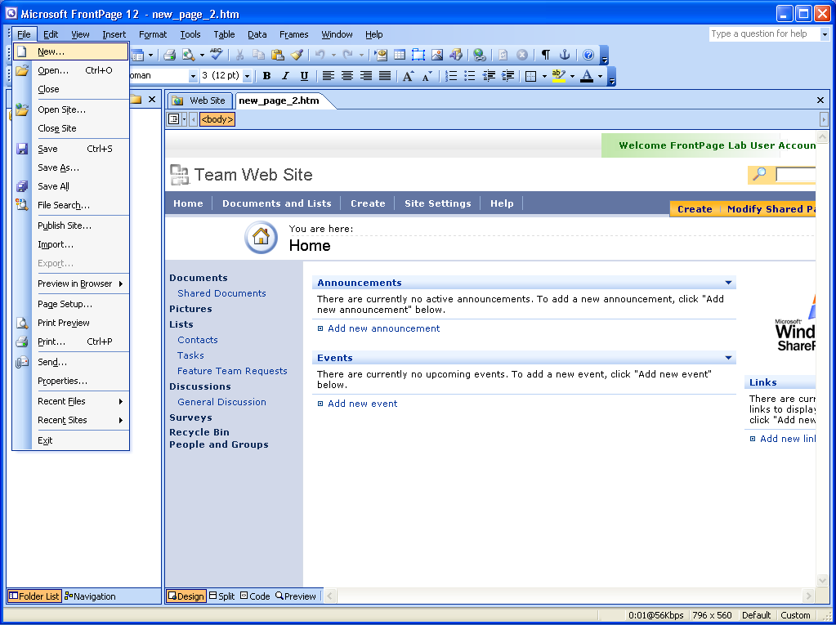
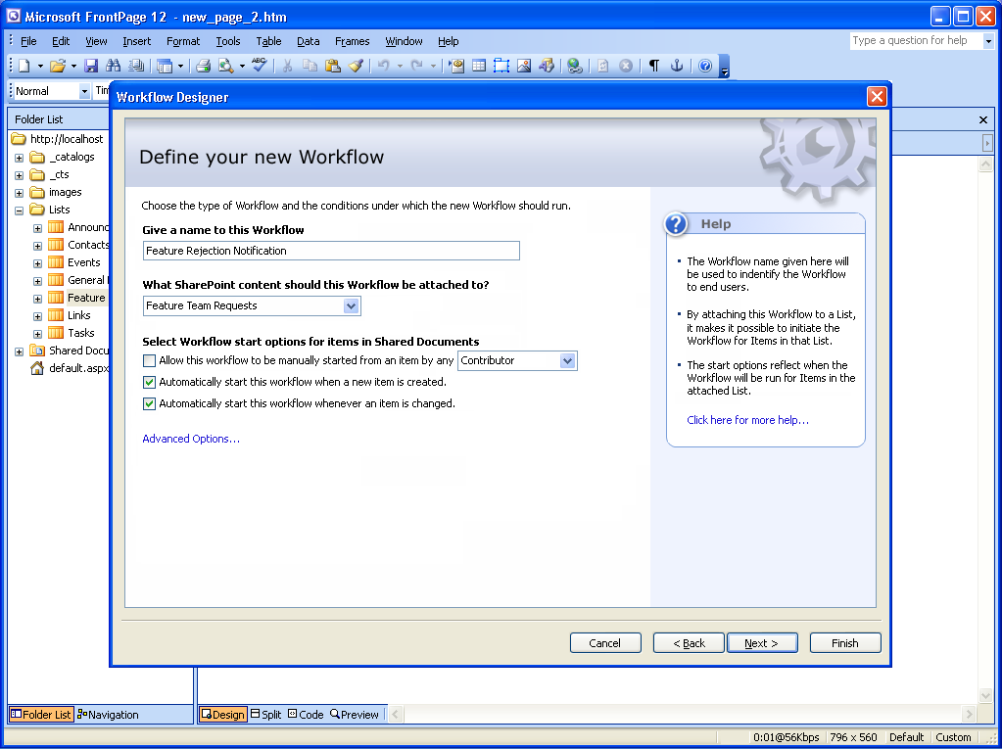
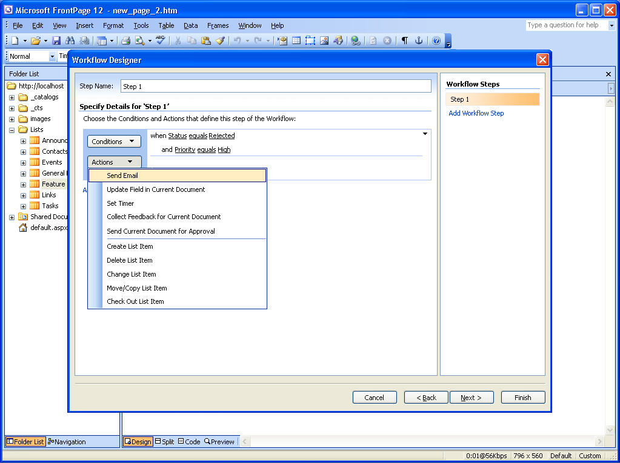
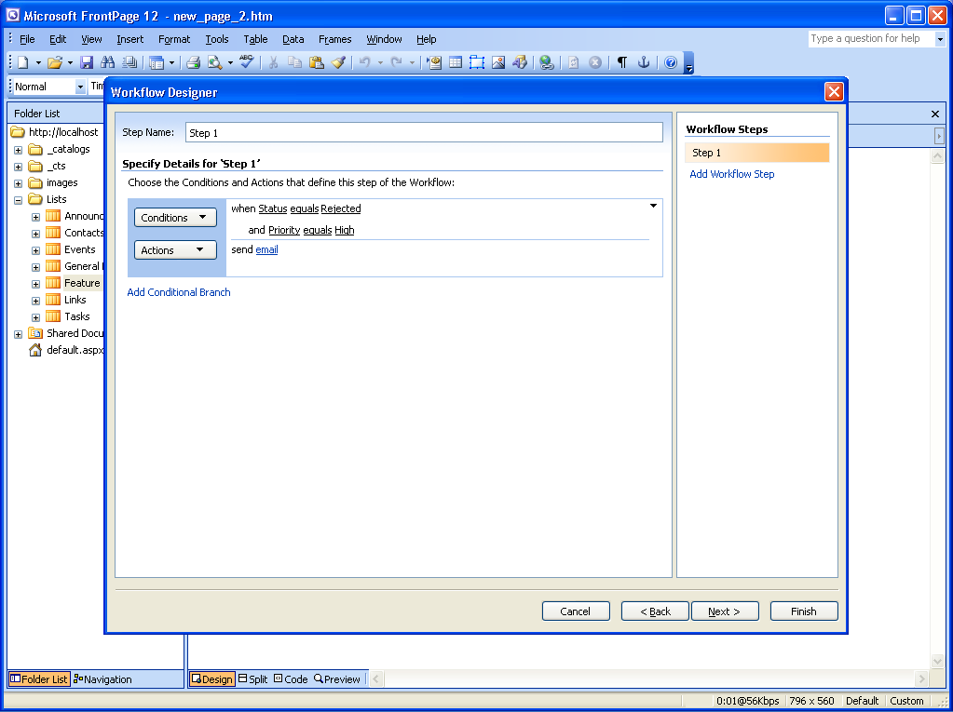
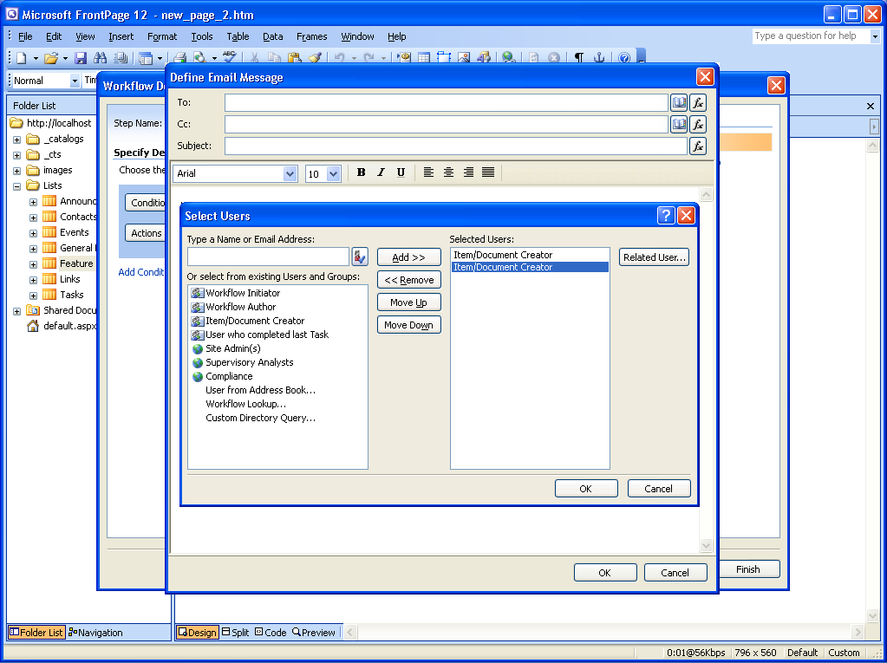
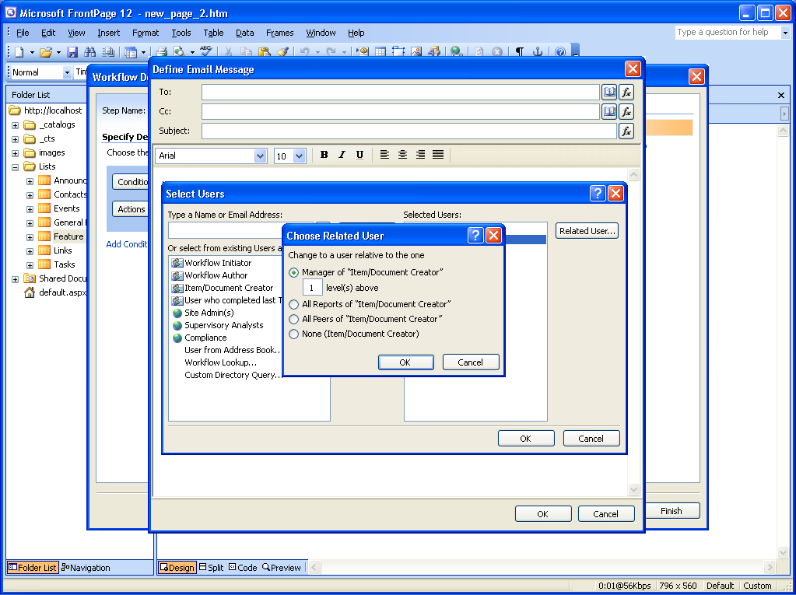
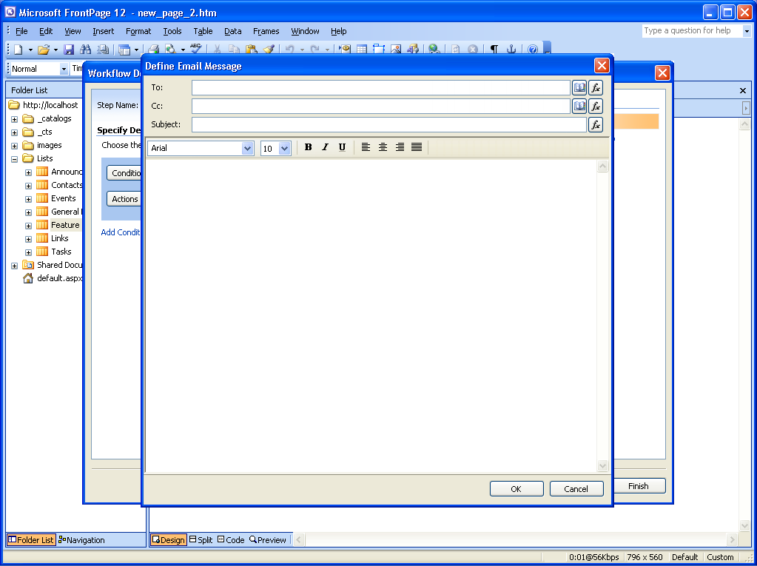
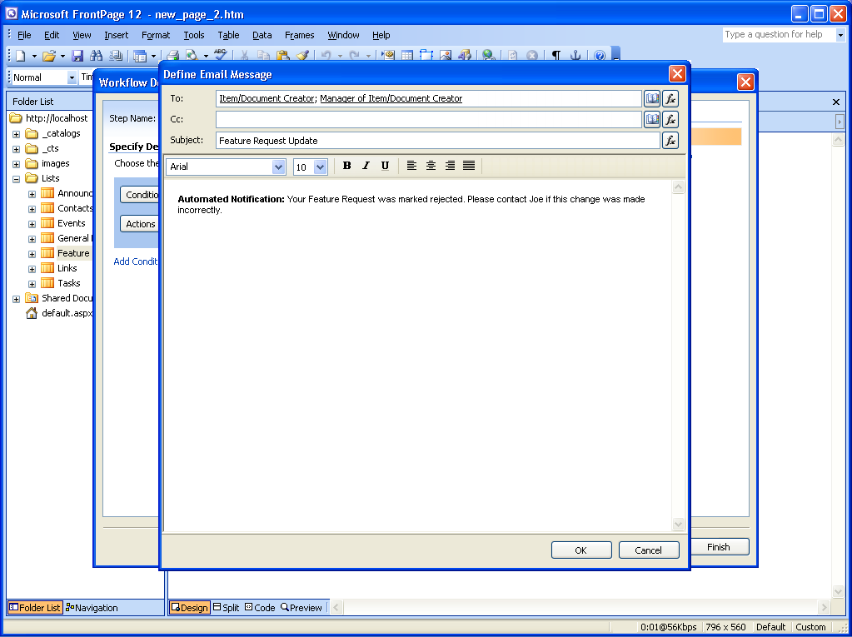
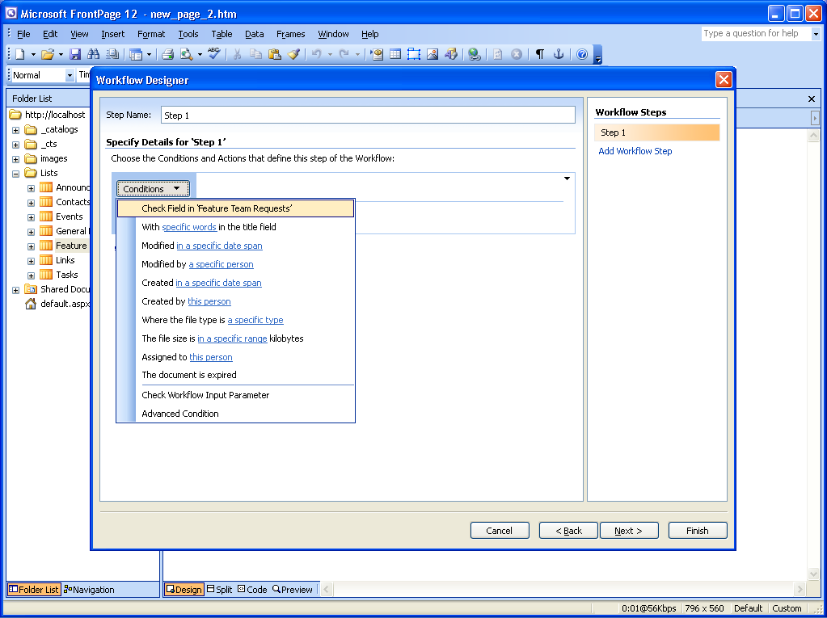
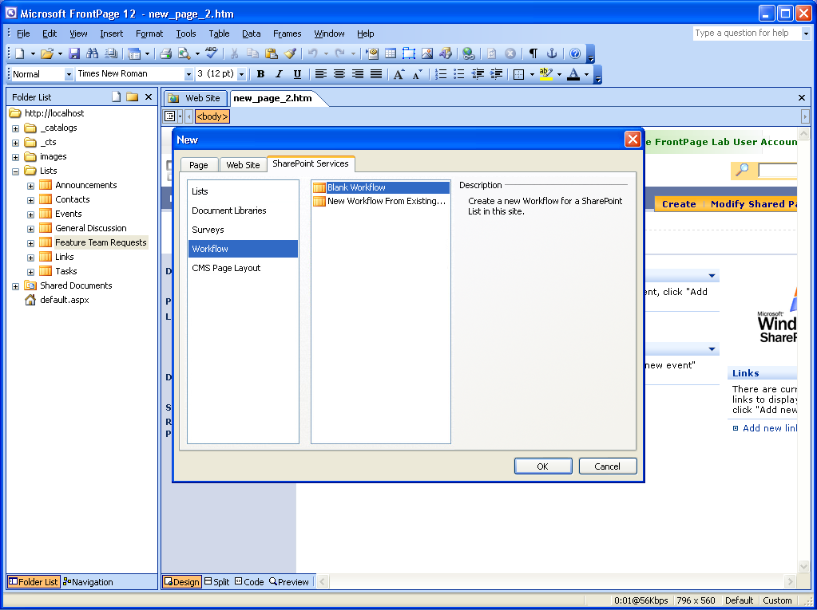
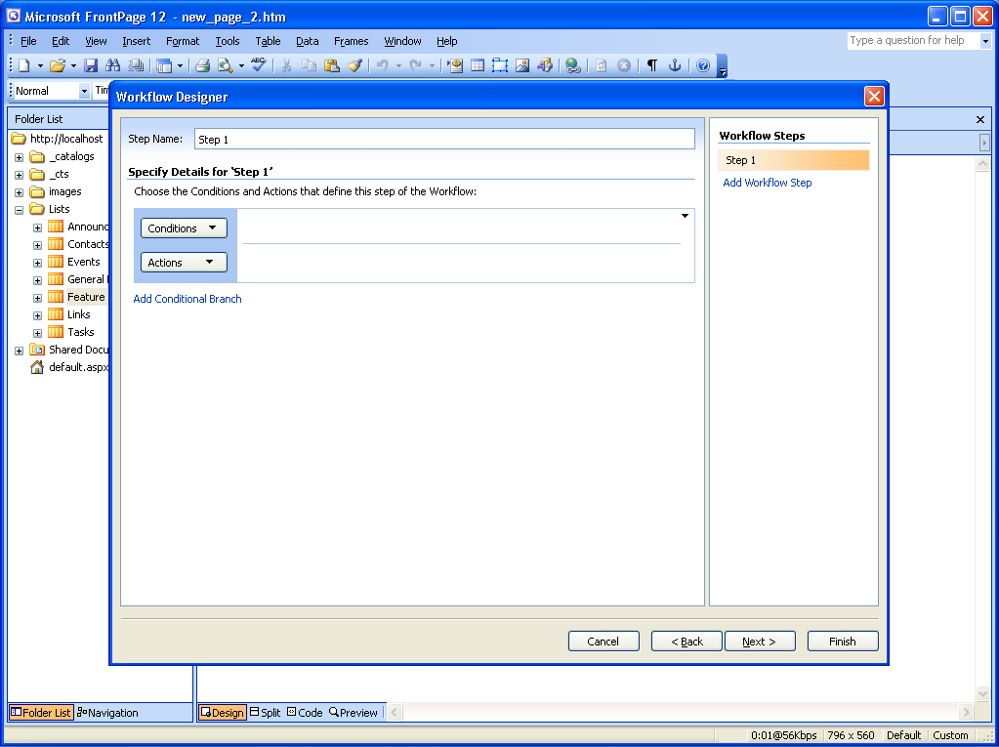
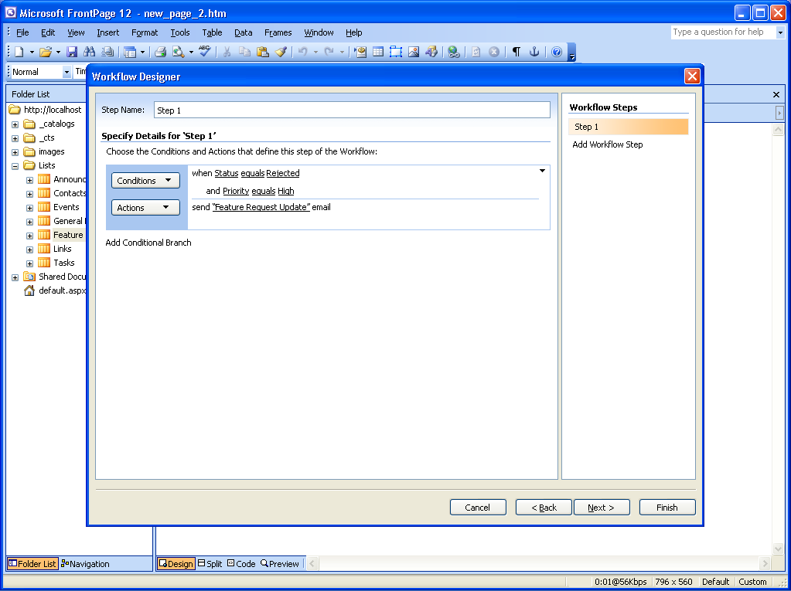
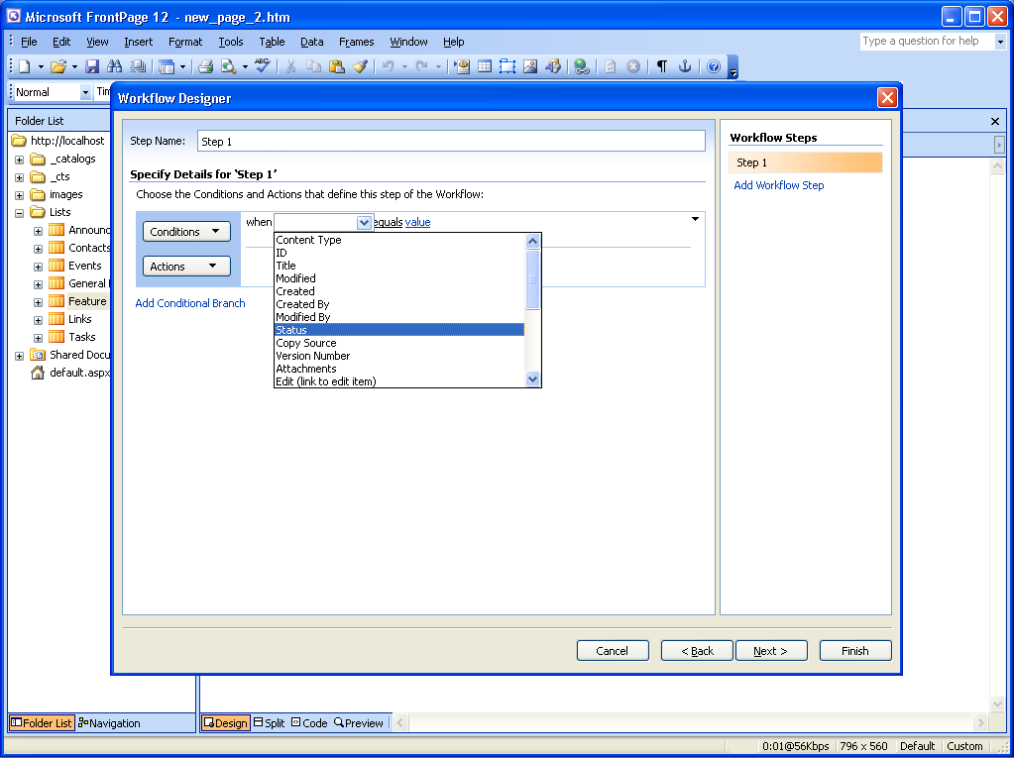
Customizable Workflow
using SharePoint Designer
Content
Management

Slide 19
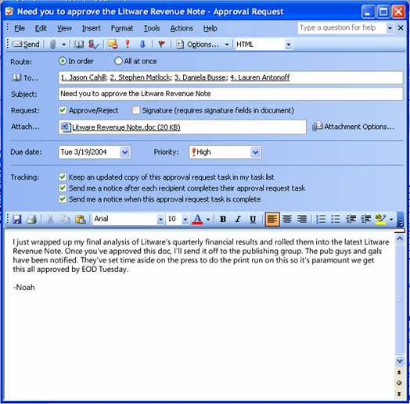
Integrated with Outlook!
Content
Management
Document approval workflow started in email
Serial or parallel approval processes
Notifications and task tracking

Slide 20
Forms Services Investments
Business
Processes
Reach more users with better forms
  Browser enabled InfoPath forms
  Offline data connections, New controls, Better printing
  Design & Compatibility Checker
  Intranet, Extranet, Internet
Automate form-driven business processes
  Forms in Outlook, including Property Promotion
  Workflow, Archiving, Information Rights Management
  Integration with Property Panel & Workflow Tasks
  Template Parts, Data Connection Library, Programmability Pane, Add-Ins
Rapidly develop and deploy form solutions in the enterprise
  Common development platform (OM, data connectivity)
  ActiveX, Windows Form and ASPX control
  Visual Studio Tools for Office, Tools for Applications
  Importer/Exporter Framework
Notes:
Learn how to enable your users to act on line-of-business data by using Business Data Catalog Actions.

Slide 21
MOSS 2007
Business Intelligence
Business
Intelligence
Business Intelligence Allow information workers to easily access critical business information, analyze and view data, and publish reports to make more informed decisions.

Slide 22


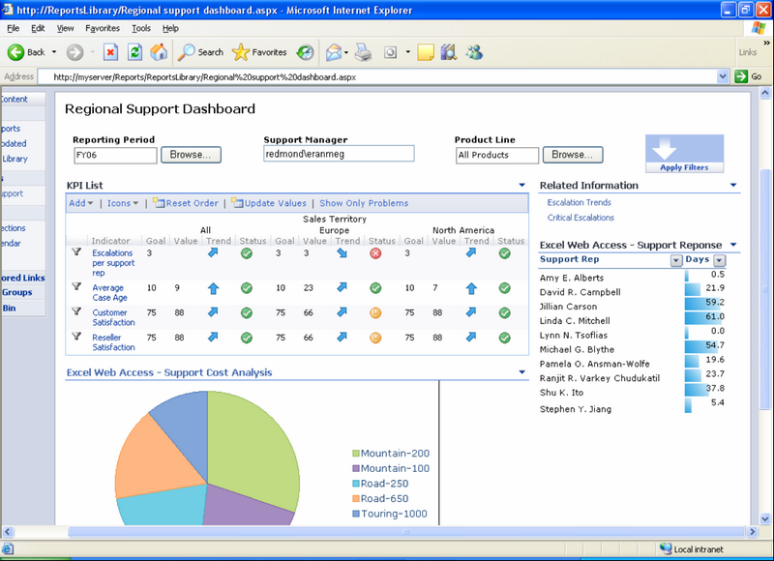
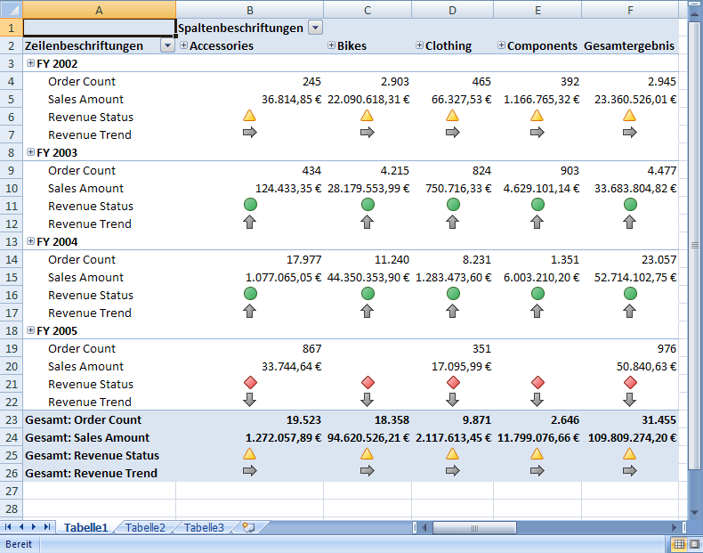

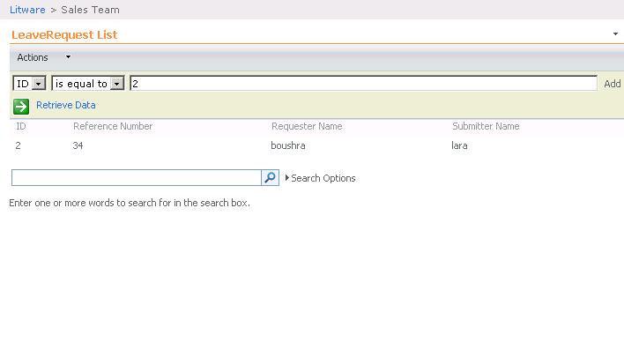





















Business Intelligence
Business
Intelligence
Web Access to Published Spreadsheets
Businss Data Catalog
Dashboards
  KPIs
  Excel Workbooks
  SQL based reports
Report Center Web Sites

Slide 23
Demo

Slide 24
Resources & Questions
Microsoft Resources:
  http://www.microsoft.com/sharepoint/
  http://blogs.msdn.com/sharepoint/
  http://www.microsoft.com/sharepoint/prodinfo/demos.mspx
Contact me:
  tghazali@sqlmvp.com
Download Presentation :
  http://www.sqlmvp.com
Thanks.

